Slide 1
Getting started with Artificial intelligence – Part 1
Shier Nee Saw, PhD
Department of Artificial Intelligence,
Faculty of Computer Science and Information Technology,
Universiti Malaya
sawsn@um.edu.my
https://shiernee.com
Notes:
Konichiwa

Slide 2
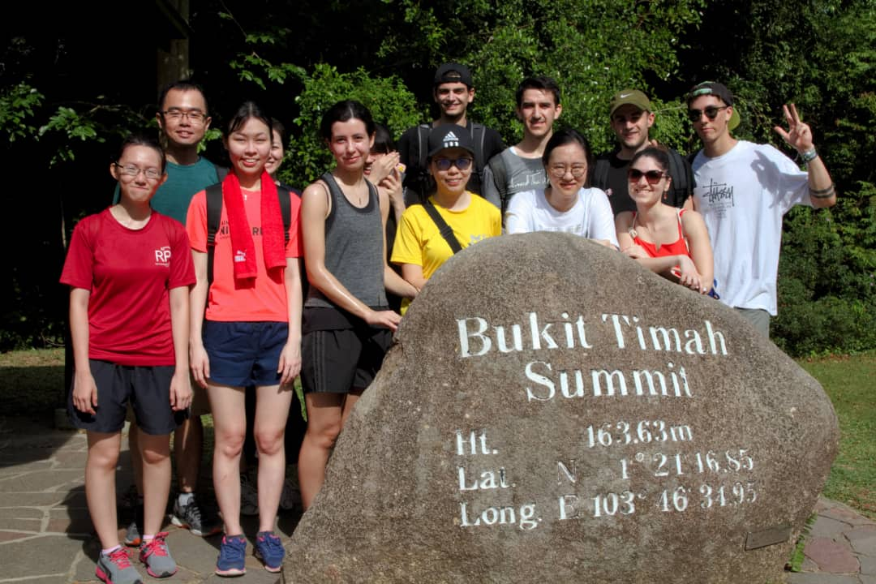



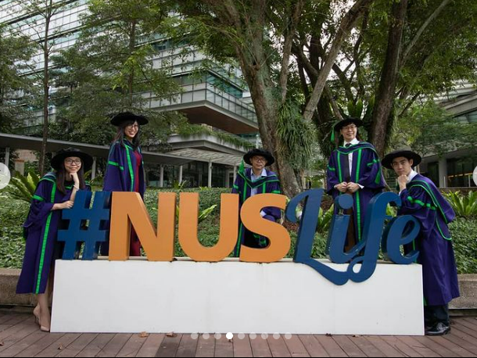
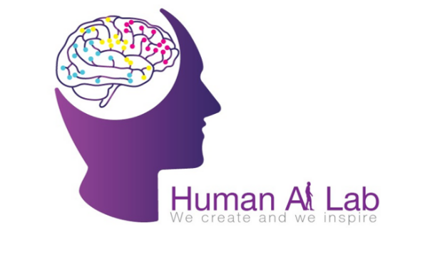
About Myself
2019-2020
Biomedical Engineering, UM, MSIA
Supported by JPA
Postdoctoral @ A*STAR,SG
2013
AI in Biomedical Applications
PhD @ NUS, SG
2015-2019
Senior Lecturer @ UM
Biomechanics Analysis Of Umbilical Vessels And Placenta Tissue In Normal And Intrauterine Growth Restriction Pregnancies.
Supported by President Graduate Fellowship
2021-Current
Research Interest:
Fetal Health Informatics,
AI in Healthcare
Email: sawsn@um.edu.my
Homepage: https://shiernee.com
Notes:
NUS – 150 hectare

Slide 3
Outline
Artificial Intelligence Overview
Classification Concept
Hands-on Python Workshop
Deep learning Models
Artificial Neural Network / Multilayer Perceptron
Convolutional Neural Network
Conclude

Slide 4
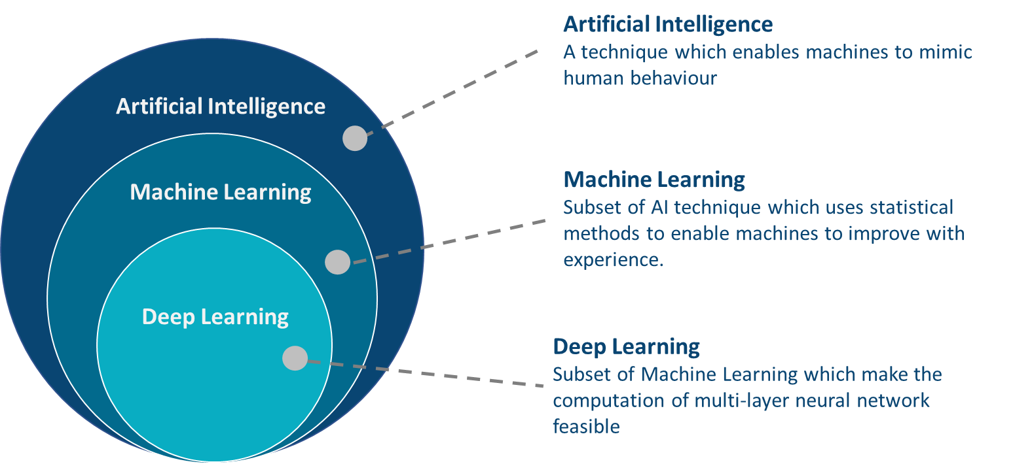
What is AI? ML? DL?

Slide 5
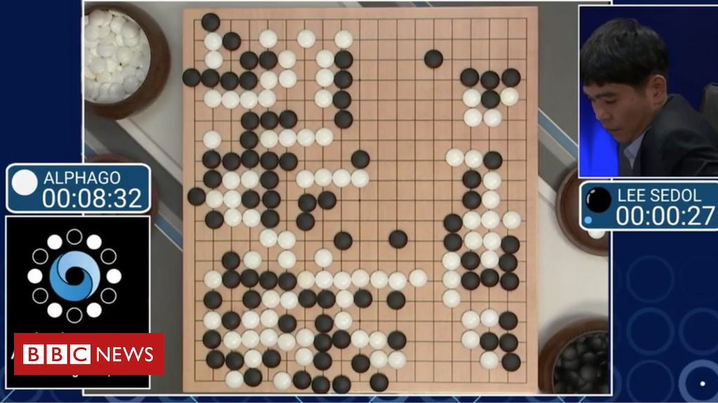
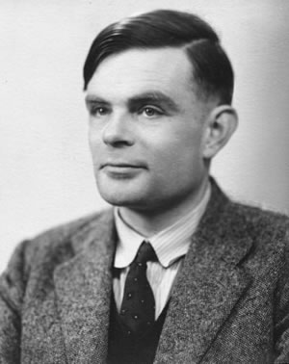
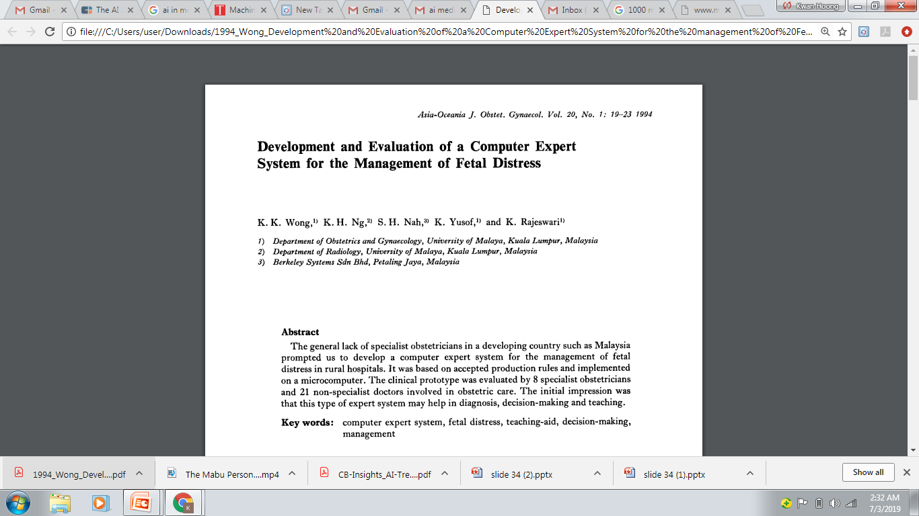
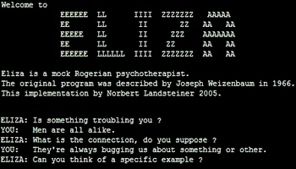
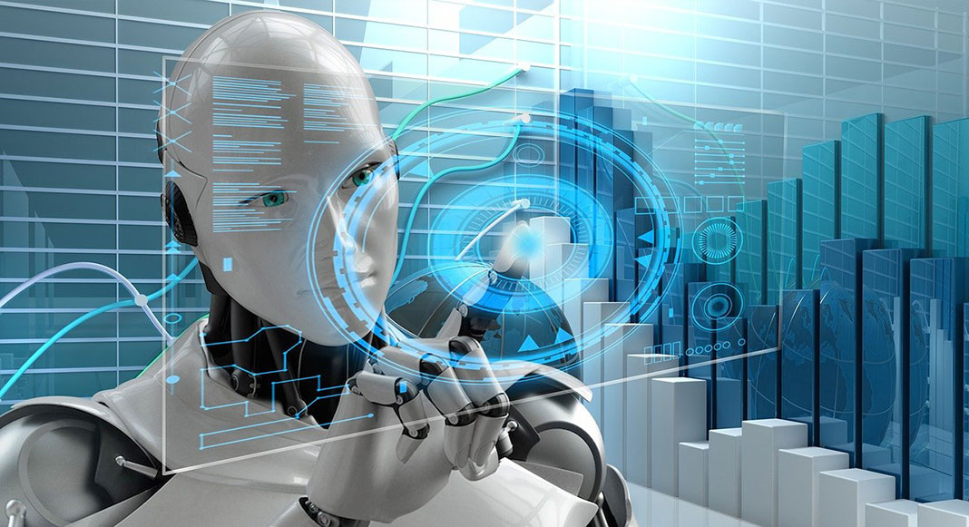
History of AI
“Can machines think?”
Alan Turing introduce a method for machine intelligence
First AI Winter
Second AI Winter
Alpha Go defeated Lee Sedol, world champion of Go
https://www.bbc.com/news/technology-35785875
https://editions.covecollective.org/chronologies/alan-turing-%E2%80%9Ccomputing-machinery-and-intelligence%E2%80%9D-1950
1950
1966
1975
1980
1987
2016
Now
First Chatbot: ELIZA
Expert System
AI in everywhere
https://www.computerhope.com/jargon/e/eliza.htm
Notes:
The history of AI starts very early. In 1950s, at the dawn of computing, Alan Turing asked the question: "Can machines think?“ and he then introduced a method to test machine intelligence. This was at a time when the first general purpose computers had only just been built. In 1966, the first chatbox – ELIZA was built. Unfortunately, AI entered the first winter in 1975 where not much people were interested in such topics and no fundings were available to support this research. In 1980, it started to gain attraction again where expert system were built. In fact, UM also involved in this where they had developed a computer expert system to manage fetal distress. In 1987, AI entered the second winter again because the system was too difficult to maintain, to update and was unable to learn. Until 2016, Alpha GO was announced to defeat Lee Sedol, the world champion of GO. This shows the world how powerful a computer can be. And then, now AI in everywhere, be it in automotive, manufacturing or healthcare.

Slide 6
AI Techniques
Supervised Learning
Reinforcement Learning
Unsupervised Learning
Labelled data with guidance
No labelled without guidance
Interacts with environment, decide action, learns by trial and error method
Notes:
Predictor/features/covariates
Label/target/response

Slide 7
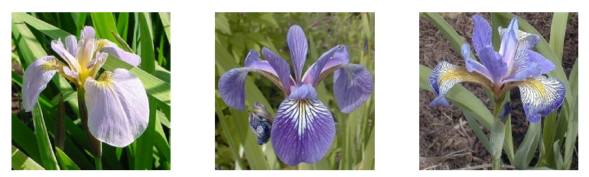
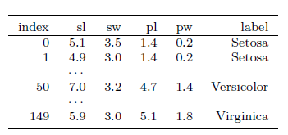
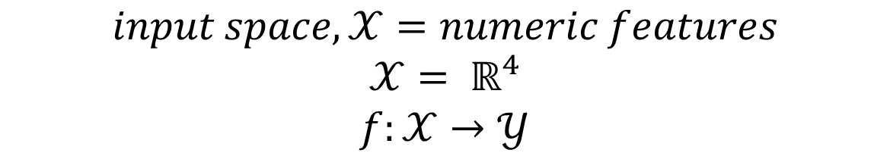
Supervised Learning - Classification
$$input space,𝒳=numeric features$$
$$𝒳= ℝ^{4}$$
$$f:𝒳→𝒴$$
Notes:
Tabular data

Slide 8
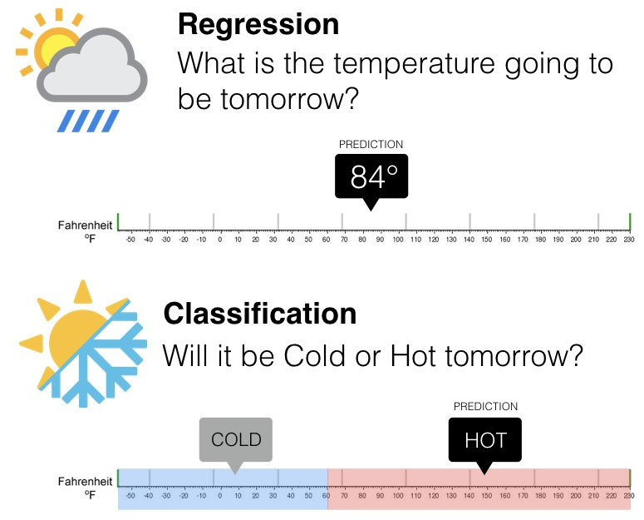
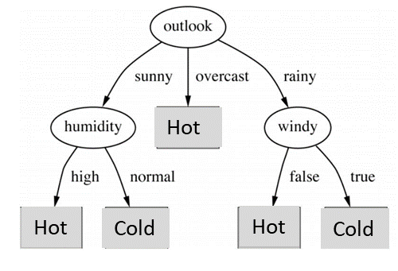
Supervised Learning - Classification
Notes:
Tabular data

Slide 9
Machine Learning Pipeline
Data Preparation
Data Splitting (Train/Test)
Model Training
Model Evaluation
Notes:
Tabular data

Slide 10
Machine Learning Pipeline
Data Preparation
Data Splitting (Train/Test)
Model Training
Model Evaluation
Data | Outlook | Humidity | Windy | Label
Data1 | Sunny | High | False | Cold
Data2 | Overcast | Normal | True | Hot
Data3 | Rainy | High | False | Hot
… | … | … |  | …
DataN | Rainy | Normal | False | Cold
Notes:
Tabular data

Slide 11
Machine Learning Pipeline
Data Preparation
Data Splitting (Train/Test)
Model Training
Model Evaluation
Data | Outlook | Humidity | Windy | Label
Data1 | Sunny | High | False | Cold
Data2 | Overcast | Normal | True | Hot
Data3 | Rainy | High | False | Hot
… | … | … |  | …
DataN | Rainy | Normal | False | Cold
70%
Training
30%
Test
Notes:
Tabular data

Slide 12
Machine Learning Pipeline
Data Preparation
Data Splitting (Train/Test)
Model Training
Model Evaluation
Data | Outlook | Humidity | Windy | Label | Prediction
Data1 | Sunny | High | False | Cold | Cold
Data2 | Overcast | Normal | True | Hot | Hot
Data3 | Rainy | High | False | Hot | Hot
… | … | … |  | …
DataN | Rainy | Normal | False | Cold
70%
Training
Notes:
Tabular data

Slide 13
Machine Learning Pipeline
Data Preparation
Data Splitting (Train/Test)
Model Training
Model Evaluation
Data | Outlook | Humidity | Windy | Label | Prediction
Data1 | Sunny | High | False | Cold | Cold
Data2 | Overcast | Normal | True | Hot | Hot
Data3 | Rainy | High | False | Hot | Hot
… | … | … |  | …
DataN | Rainy | Normal | False | Cold | Hot
30%
Test
Notes:
Tabular data

Slide 14
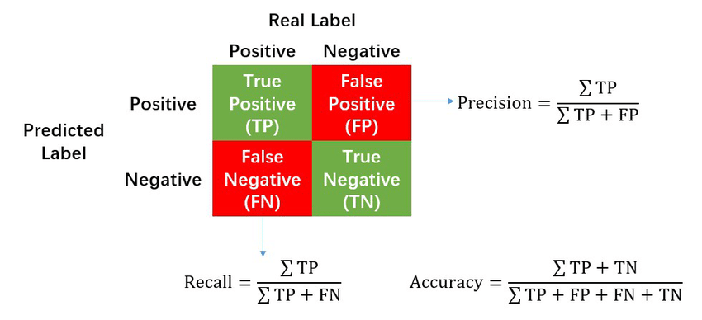
Model Evaluation
A perfect model should predict all testing data correctly → Accuracy = 100% (the higher the better)
Notes:
Tabular data

Slide 15
Hands-on Python Workshop

Slide 16
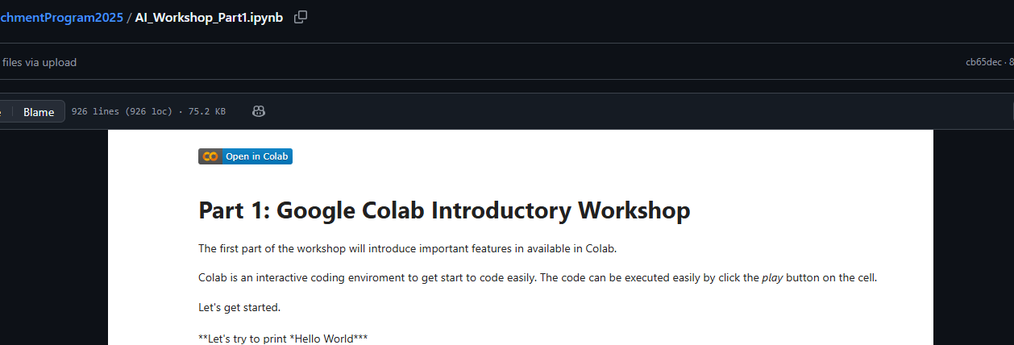
Course Materials
Google Colab Introduction Hands-on Workshop
Please go to this link. We will go through the code here.
https://github.com/shiernee/FASS_SummerEnrichmentProgram2025/blob/main/AI_Workshop_Part1.ipynb
2. Click “Open in Colab”
3. Save a copy in your drive.
File
Save a copy in Drive

Slide 17
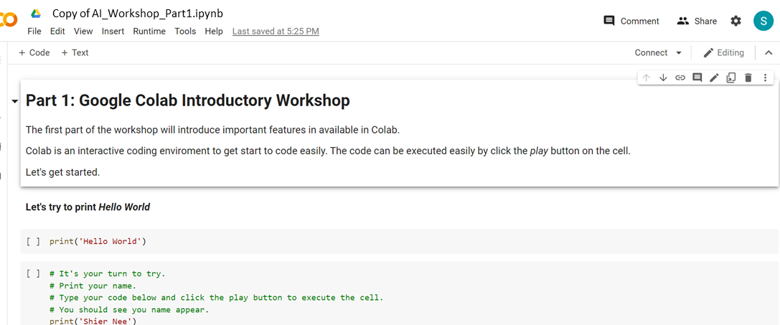
Google Colab
Google Colab Introduction Hands-on Workshop
Please go to this link. We will go through the code here.
https://github.com/shiernee/FASS_SummerEnrichmentProgram2025/blob/main/AI_Workshop_Part1.ipynb
2. Click “Open in Colab”
3. Save a copy in your drive.
File
Save a copy in Drive
You should see the name change to
“Copy of AI_Workshop_Part1.ipynb”

Slide 18
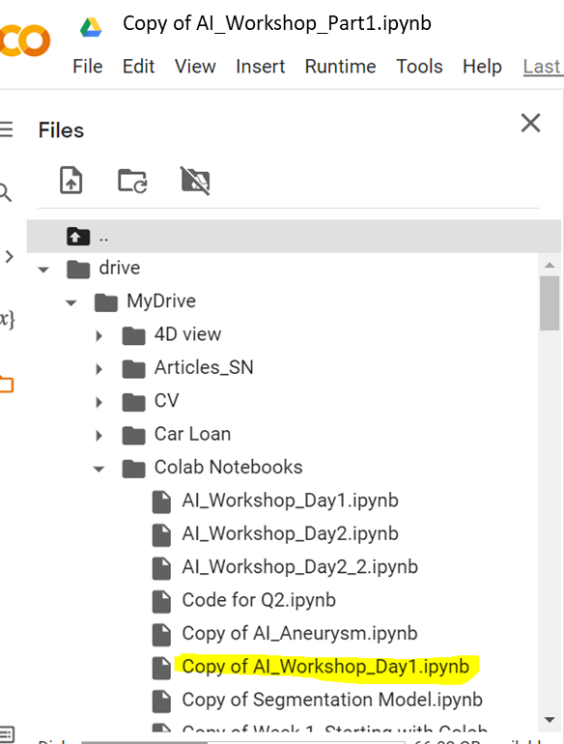
Google Colab
Google Colab Introduction Hands-on Workshop
Please go to this link. We will go through the code here.
https://github.com/shiernee/Getting_Started_with_AI_Tutorial/blob/main/AI_Workshop_Day1.ipynb
2. Click “Open in Colab”
3. Save a copy in your drive.
File
Save a copy in Drive
You should see the name change to
“Copy of AI_Workshop_Part1.ipynb”
You should also see your ipynb file
Is in your google drive

Slide 19
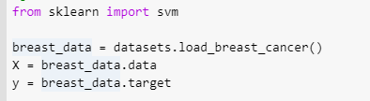
Classification
To try with your datasets. Replace the datasets to your datasets for
X, y

Slide 20
Deep Learning Model

Slide 21
Artificial Neural Network
Made up of multiple layers of nodes.
Each layer make simple decisions using different weights, w, bias, b and activation function, σ.
Trainable parameters
Input layer
Hidden layer
Output layer
b¹₁
σ
W²₁₁
W¹₁₁
b²₁
W¹₁₂
b¹₂
W²₁₂
σ
σ
b¹₃
b²₂
σ
σ
b¹₄
σ
Notes:
Tabular data

Slide 22
Artificial Neural Network
Made up of multiple layers of nodes.
Each layer make simple decisions using different weights, w, bias, b and activation function, σ.
Learnable parameters
Input layer
Hidden layer
Output layer
σ
W²₁₁
W¹₁₁
Age
W¹₁₂
W²₁₂
σ
Normal Blood Pressure
σ
BMI
σ
σ
High Blood Pressure
Cholesterol level
σ
Notes:
Tabular data

Slide 23
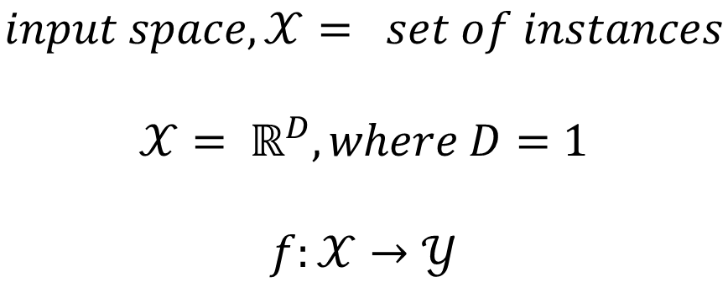
Artificial Neural Network
Input layer
Hidden layer
Output layer
σ
W²₁₁
W¹₁₁
Age
W¹₁₂
W²₁₂
σ
Normal Blood Pressure
σ
BMI
σ
σ
High Blood Pressure
Cholesterol level
σ
$$input space,𝒳= set of instances$$
$$𝒳= ℝ^{D}, where D=1$$
$$f:𝒳→𝒴$$
Notes:
Tabular data

Slide 24
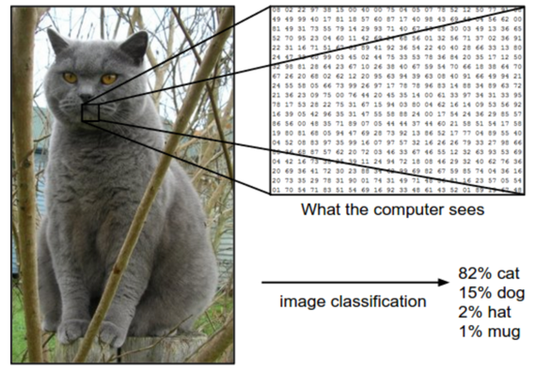

Convolutional Neural Network
When your input is a Grey Scaled Image
$$input space,𝒳= set of images$$
$$𝒳= ℝ^{D}, where D=2$$
$$f:𝒳→𝒴$$
Notes:
Tabular data

Slide 25
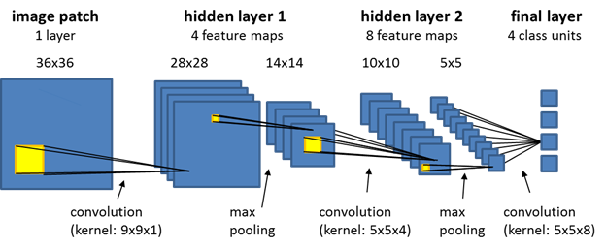
Convolutional Neural Network
Trainable parameters:
Weight in the kernel
Notes:
Image data

Slide 26
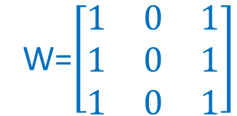
Convolution
1 | 0 | 1 | 1 | 0 | 1
1 | 1 | 1 | 1 | 1 | 0
0 | 0 | 0 | 1 | 1 | 1
0 | 0 | 1 | 1 | 1 | 0
1 | 1 | 1 | 1 | 0 | 0
0 | 1 | 0 | 1 | 0 | 0
Convolution
4
Kernel
W=$\left[\begin{matrix}1 & 0 & 1 \\ 1 & 0 & 1 \\ 1 & 0 & 1\end{matrix}\right]$
Layer i
Layer i+1

Slide 27
CNN
Convolution
CNN
1 | 0 | 1 | 1 | 0 | 1
1 | 1 | 1 | 1 | 1 | 0
0 | 0 | 0 | 1 | 1 | 1
0 | 0 | 1 | 1 | 1 | 0
1 | 1 | 1 | 1 | 0 | 0
0 | 1 | 0 | 1 | 0 | 0
Convolution
4 | 4
Layer i
Layer i+1

Slide 28
CNN
Convolution
CNN
1 | 0 | 1 | 1 | 0 | 1
1 | 1 | 1 | 1 | 1 | 0
0 | 0 | 0 | 1 | 1 | 1
0 | 0 | 1 | 1 | 1 | 0
1 | 1 | 1 | 1 | 0 | 0
0 | 1 | 0 | 1 | 0 | 0
Convolution
4 | 4 | 4
Layer i
Layer i+1

Slide 29
CNN
Convolution
CNN
1 | 0 | 1 | 1 | 0 | 1
1 | 1 | 1 | 1 | 1 | 0
0 | 0 | 0 | 1 | 1 | 1
0 | 0 | 1 | 1 | 1 | 0
1 | 1 | 1 | 1 | 0 | 0
0 | 1 | 0 | 1 | 0 | 0
Convolution
4 | 4 | 4 | 5
Layer i
Layer i+1

Slide 30
CNN
Convolution
CNN
1 | 0 | 1 | 1 | 0 | 1
1 | 1 | 1 | 1 | 1 | 0
0 | 0 | 0 | 1 | 1 | 1
0 | 0 | 1 | 1 | 1 | 0
1 | 1 | 1 | 1 | 0 | 0
0 | 1 | 0 | 1 | 0 | 0
4 | 4 | 4 | 5
4
Convolution
Layer i
Layer i+1

Slide 31
CNN
Convolution
CNN
1 | 0 | 1 | 1 | 0 | 1
1 | 1 | 1 | 1 | 1 | 0
0 | 0 | 0 | 1 | 1 | 1
0 | 0 | 1 | 1 | 1 | 0
1 | 1 | 1 | 1 | 0 | 0
0 | 1 | 0 | 1 | 0 | 0
Repeat the rest
4 | 4 | 4 | 5
4 | 4 | 5 | 4
3 | 3 | 4 | 4
3 | 5 | 3 | 3
Feature extracted
Layer i
Layer i+1

Slide 32
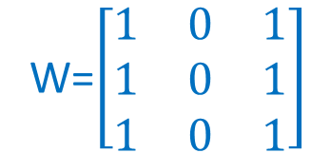
CNN
Convolution
CNN
1 | 0 | 1 | 1 | 0 | 1
1 | 1 | 1 | 1 | 1 | 0
0 | 0 | 0 | 1 | 1 | 1
0 | 0 | 1 | 1 | 1 | 0
1 | 1 | 1 | 1 | 0 | 0
0 | 1 | 0 | 1 | 0 | 0
Repeat the rest
4 | 4 | 4 | 5
4 | 4 | 5 | 4
3 | 3 | 4 | 4
3 | 5 | 3 | 3
W=$\left[\begin{matrix}1 & 0 & 1 \\ 1 & 0 & 1 \\ 1 & 0 & 1\end{matrix}\right]$
Feature extracted
Trainable parameter
Layer i
Layer i+1

Slide 33
CNN
Convolution
CNN
Repeat for next layer
4 | 4 | 4 | 5
4 | 4 | 5 | 4
3 | 3 | 4 | 4
3 | 5 | 3 | 3
24 | 24
22 | 23
W=$\left[\begin{matrix}1 & 0 & 1 \\ 1 & 0 & 1 \\ 1 & 0 & 1\end{matrix}\right]$
Feature extracted
Trainable parameter
Layer i+1
Layer i+2

Slide 34
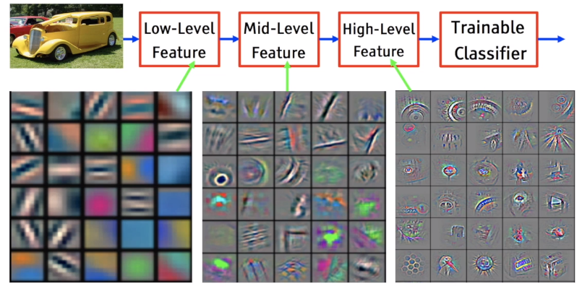
Feature Extraction

Slide 35
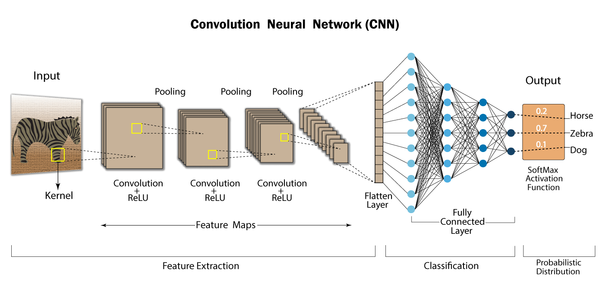
CNN
Supervised Learning - Classification
From https://developersbreach.com/convolution-neural-network-deep-learning/

Slide 36
Breast Cancer Classification - ANN
Data Preparation
Data Splitting
Training
Testing
ANN
Model Evaluation using Testing Data
σ
W²₁₁
W¹₁₁
Mean radius
W¹₁₂
W²₁₂
σ
Benign
σ
Mean texture
σ
σ
Malignant
Mean perimeter
σ

Slide 37
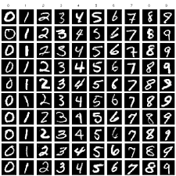
MNIST Classification - CNN
Data Preparation
Data Splitting
Training
Testing
CNN
Model Evaluation using Testing Data
MNIST Dataset

Slide 38
Hands-on Python Workshop (Self-learning)

Slide 39
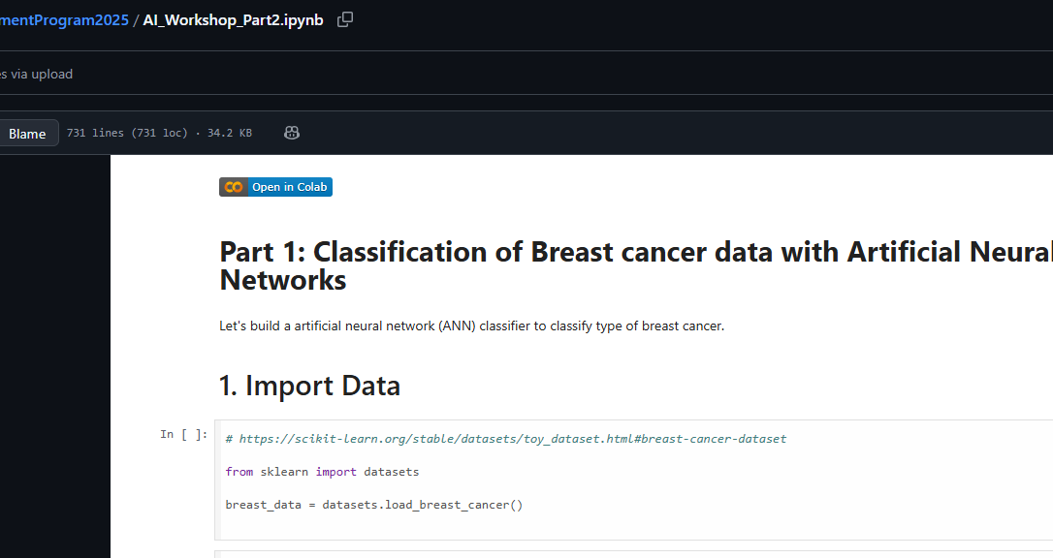
Course Materials
Google Colab Introduction Hands-on Workshop
Please go to this link. We will go through the code here.
https://github.com/shiernee/FASS_SummerEnrichmentProgram2025/blob/main/AI_Workshop_Part2.ipynb
2. Click “Open in Colab”
3. Save a copy in your drive.
File
Save a copy in Drive

Slide 40
Google Colab
Google Colab Introduction Hands-on Workshop
Please go to this link. We will go through the code here.
https://github.com/shiernee/FASS_SummerEnrichmentProgram2025/blob/main/AI_Workshop_Part2.ipynb
2. Click “Open in Colab”
3. Save a copy in your drive.
File
Save a copy in Drive
You should see the name change to
“Copy of AI_Workshop_Part2.ipynb”

Slide 41
Conclude
Artificial Intelligence Overview
Classification Concept
Multilayer Perceptron
Convolutional Neural Network
Hands-on Python Workshop

Slide 42
Additional Info
K-fold cross validation - https://machinelearningmastery.com/k-fold-cross-validation/
Hyperparameter Tuning – https://machinelearningmastery.com/hyperparameter-optimization-with-random-search-and-grid-search/
AutoML Framework - https://nbviewer.org/github/pycaret/pycaret/blob/master/tutorials/Binary%20Classification%20Tutorial%20Level%20Beginner%20-%20%20CLF101.ipynb

Slide 43
Additional Reference
Applied Machine Learning Process - https://machinelearningmastery.com/start-here/#process
Basic Convolutional Neural Network - https://towardsdatascience.com/basics-of-the-classic-cnn-a3dce1225add
How does Convolutional Neural Networks work? https://e2eml.school/how_convolutional_neural_networks_work.html

